Slide 1
Chinook
Music Store Analysis
Data-Driven Customer & Sales Insights
Praveen Raj S
20.07.2025

Slide 2
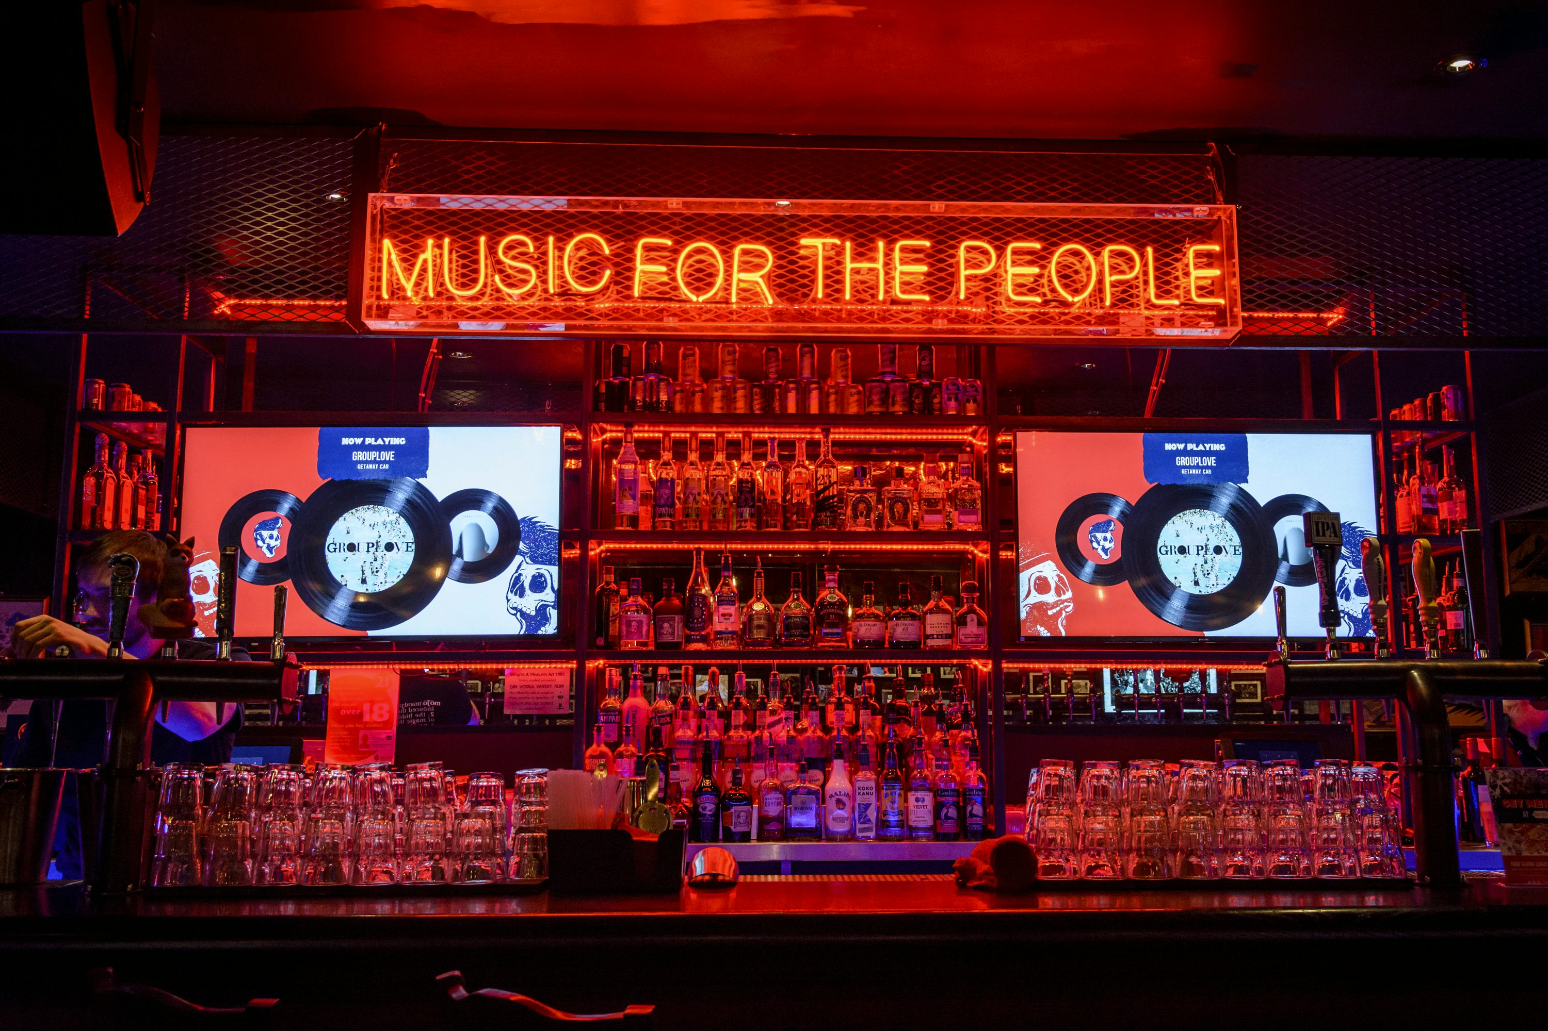
行业PPT模板http://www.1ppt.com/hangye/
INTRODUCTION
Chinook is a digital music store that sells individual tracks and albums from a variety of artists and genres.
This project aims to analyze the customer base, sales performance, and product patterns using SQL-based data analysis.
Provide actionable insights to support strategic decisions in marketing, customer retention, and regional targeting

Slide 3

行业PPT模板http://www.1ppt.com/hangye/
OBJECTIVES
Analyze customer behavior based on geography, spending, and purchase frequency
Identify top-selling tracks, albums, genres, and artists by revenue and volume
Understand regional trends to support targeted marketing and product localization
Evaluate customer retention and churn patterns
Discover product affinities to support cross-selling and recommendation strategies
Provide data-driven recommendations for business growth and customer engagement

Slide 4

行业PPT模板http://www.1ppt.com/hangye/
Chinook Music Store Data
Customers: Information such as name, contact details, and country.
Invoices & Invoice Lines: Transaction records and individual track purchases.
Tracks & Albums: Details about songs, albums, and associated metadata.
Artists & Genres: Information about music creators and their genre classification.
Employees: Internal team managing customer relationships.
Media Types: Format of the track (e.g., MPEG audio, AAC audio).

Slide 5
行业PPT模板http://www.1ppt.com/hangye/
Data Cleaning
Handled Missing Values:
Filled nulls in columns like company, state, postal_code, fax, and phone in the customer table with placeholders such as 'N/A' or 'Unknown'
Set missing composers in the track table to 'Unknown'
Retained the null value in the employee table where it represented the top-most manager (reports_to)
Checked for Duplicates: Verified that all tables had no duplicate rows based on key columns
Standardized Data Types and Formats: Ensured consistent data types across joins and aggregations (e.g., dates, prices, quantities)

Slide 6

行业PPT模板http://www.1ppt.com/hangye/
Methodology
SQL (MySQL Workbench v8.0.22) for Data Analysis:
Joins: Combined data across multiple tables like customer, invoice, track, artist, etc.
Aggregations & Grouping: Used GROUP BY, SUM, AVG, COUNT, and ROUND to compute customer behavior and sales trends.
Filters & Conditions: Applied WHERE, HAVING, and CASE logic to identify churn, genre distribution, etc.
Window Functions: Employed RANK() and ROW_NUMBER() for customer segmentation and identifying top performers.
Views, CTEs & Subqueries: Created reusable logic to simplify complex queries and repeated calculations.
Date Functions: Used MAX, DATE_SUB, and DATEDIFF to evaluate time-based metrics like last purchases and tenure.

Slide 7
行业PPT模板http://www.1ppt.com/hangye/
Methodology
Excel for Visualization:
Cleaned query outputs were exported to Excel
Used charts such as bar charts, line graphs, and pie charts for communicating insights clearly and visually.

Slide 8
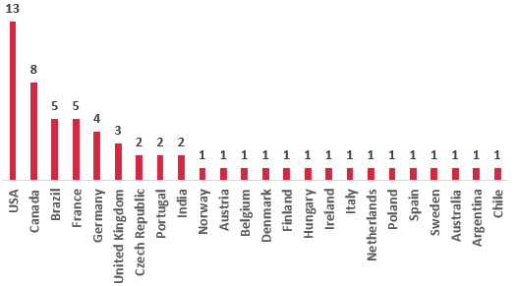
Customer Demographics by Country
Total Customers per Country
Majority of customers are from the USA, followed by Canada and Brazil.
Customers are concentrated in North and South America, with fewer from Europe and Asia.
Marketing efforts can be focused on top-performing regions for better Retrun Of Investment(ROI).
Countries with low customer counts might be untapped markets.
Localization strategies could improve engagement in non-English-speaking countries.

Slide 9
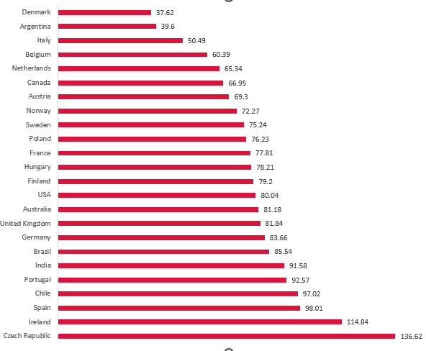
Identifying Potential Markets
Average Revenue per Country
Customers are distributed across 24 countries, with the highest representation from the USA, Canada, France, Brazil, and Germany.
The USA has the largest customer base but shows relatively lower average revenue per customer compared to countries like the Czech Republic and Ireland.
Countries like Czech Republic, Ireland, and Spain show higher average spending, making them attractive for premium targeting.
Future segmentation should consider region-based preferences and value tiers for personalized marketing strategies.

Slide 10
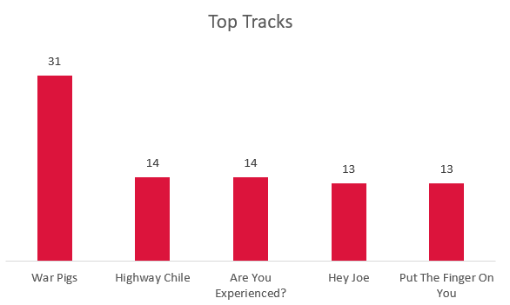
Top-Selling Tracks, Artists and Genres
Rock is the top-selling genre globally, indicating strong and consistent demand across regions.
Van Halen leads as the most purchased artist worldwide.
War Pigs leads as the most purchased track worldwide.
Genre combinations such as Rock & Metal are frequently purchased together, suggesting strong affinity.
Promotions and campaigns should prioritize Rock, Alternative, aMetal nd Metal for maximum global reach.

Slide 11
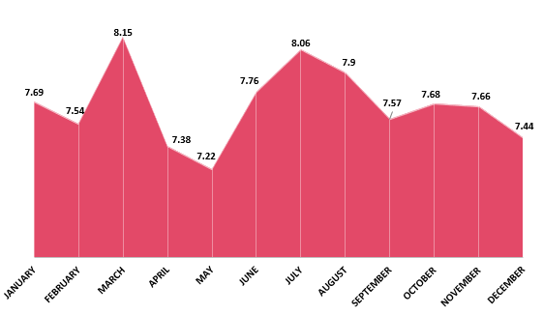
Monthly Average Order Value Trend
The average order value (AOV) fluctuates throughout the year, peaking in March (8.15) and July (8.06), indicating higher-value purchases in those months.
May (7.22) has the lowest AOV, suggesting customers either purchased fewer items or opted for cheaper tracks.
March and July spikes may correspond to seasonal campaigns or popular artist/album releases.
A fairly stable range (7.2–8.1) across months reflects consistent pricing and purchase behavior.
These trends help identify optimal months for upselling or bundling strategies.

Slide 12
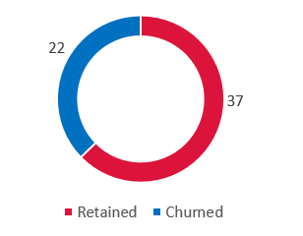
Customer Churn Rate Analysis
Out of 59 total customers, 22 customers haven’t made a purchase in the last 3 months.
A churn rate of 37.29% highlights a significant retention challenge for Chinook.
Customers with fewer purchases and lower average spending are more likely to churn.
Timely interventions like personalized offers or re-engagement campaigns could reduce churn.
Monitoring purchase recency is crucial for building an effective customer loyalty strategy.

Slide 13
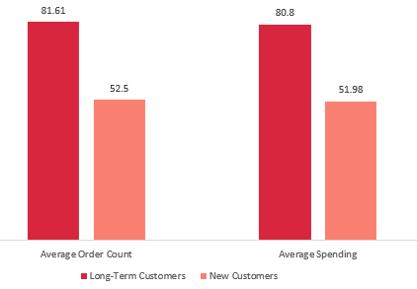
Purchase Patterns of Long-Term vs New Customers
Long-Term customers place 55% more orders than New customers.
They also contribute 55% more revenue on average.
Average order value is consistent across both groups, indicating frequency, drives higher revenue.
These insights emphasize the value of customer retention.
Invest in loyalty programs, personalized offers, or subscription models to retain and reward long-term customers.

Slide 14
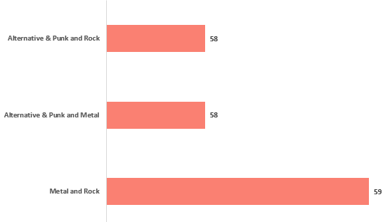
Genre Pair Purchase Trends
Metal, Rock, and Alternative & Punk frequently appear together, suggesting strong listener overlap.
These combinations present opportunities for playlist bundling, cross-genre recommendations, and multi-genre promotions.
Targeted marketing can leverage these affinities to boost average cart size and customer satisfaction.

Slide 15
行业PPT模板http://www.1ppt.com/hangye/
Conclusion
The analysis of Chinook’s customer and sales data provided valuable insights into purchase behavior, genre preferences, and churn patterns.
Rock, Metal, and Alternative & Punk are the most dominant and frequently paired genres, showing clear opportunities for cross-promotion and bundling.
Long-term customers contribute significantly more to revenue, emphasizing the need for customer retention strategies like loyalty programs or personalized offers.
Monthly and regional trends revealed performance fluctuations, helping identify key timeframes and countries for targeted marketing.
These insights can drive data-informed business decisions, enhancing revenue through strategic promotions, targeted ads, and curated recommendations.

Slide 16
2025
Thank you
Praveen Raj S
20.07.2025

